Slide 1
Chapter 8: Printers
Instructor Materials
IT Essentials v7.0
Notes:
Cisco Networking Academy Program
IT Essentials v7.0
Chapter 8: Printers

Slide 2
Instructor Materials – Chapter 8 Planning Guide
This PowerPoint deck is divided in two parts:
Instructor Planning Guide
Information to help you become familiar with the chapter
Teaching aids
Instructor Class Presentation
Optional slides that you can use in the classroom
Begins on slide #13
Note: Remove the Planning Guide from this presentation before sharing with anyone.
Notes:
2

Slide 3
Chapter 8: Printers
IT Essentials 7.0 Planning Guide
Notes:
Cisco Networking Academy Program
IT Essentials v7.0
Chapter 8: Printers

Slide 4
Check Your Understanding and What Do You Already Know?
Check Your Understanding activities used to be called Interactive Activities. They simply have a new name. They are designed to let students quickly determine if they understand the content and can proceed, or if they need to review.
Check Your Understanding activities do not affect student grades.
Activities listed as What Do You Already Know? are a type of activity in which we ask the student to simply take a guess! It is not meant to evaluate their knowledge. It is only meant to give them a head start in thinking about different topics before they are presented in the course. Students receive addition content in the form of feedback for any answers they select.
What Do You Already Know? activities do not directly affect student grades; however, the feedback may contain content which appears later in quizzes and exams, so it is important that students complete the What Do You Already Know? activities.
Notes:
4

Slide 5
Chapter 8: Activities
What activities are associated with this chapter?
Page # | Activity Type | Activity Name | Optional?
8.1.1.5 | Check Your Understanding | Printer Capabilities and Characteristics | Recommended
8.1.2.2 | Check Your Understanding | Printer Connections | Recommended
8.2.1.3 | Check Your Understanding | Inkjet Printers | Recommended
8.2.2.3 | Check Your Understanding | Laser Printers | Recommended
8.2.3.2 | Check Your Understanding | The Laser Printing Process | Recommended
8.2.4.3 | Check Your Understanding | Thermal Printers and Impact Printers | Recommended
8.2.5.3 | Check Your Understanding | Virtual Printers | Recommended
8.2.6.3 | Check Your Understanding | 3D Printers | Recommended
8.3.1.2 | Lab | Install a Printer in Windows | Recommended
8.3.2.2 | Check Your Understanding | Configuration Options | Recommended
8.3.3.3 | Check Your Understanding | Printer Optimization (Figure 1) | Recommended
8.3.3.3 | Check Your Understanding | Printer Hardware Optimization (Figure 2) | Recommended
Notes:
5

Slide 6
Chapter 8: Activities (Cont.)
What activities are associated with this chapter?
Page # | Activity Type | Activity Name | Optional?
8.4.1.3 | Lab | Share a Printer in Windows | Recommended
8.4.2.5 | Check Your Understanding | Print Servers | Recommended
8.5.1.2 | What Do You Already Know | Printer Operating Environment | Recommended
8.5.2.1 | Video Demonstration | Inkjet Printer Preventive Maintenance | Recommended
8.5.2.2 | Lab | Perform Preventive Maintenance on an Inkjet Printer | Recommended
8.5.3.1 | Video Demonstration | Laser Printer Preventive Maintenance | Recommended
8.5.3.2 | Lab | Preventive Maintenance on a Laser Printer | Recommended
8.5.4.2 | Check Your Understanding | Thermal Printer Preventive Maintenance | Recommended
8.5.5.2 | Check Your Understanding | Impact Printer Preventive Maintenance | Recommended
8.5.6.1 | Video Demonstration | 3D Printer Preventive Maintenance | Recommended
8.5.6.2 | Video Demonstration | 3D Printer Printing a Component | Recommended
Notes:
6

Slide 7
Chapter 8: Assessment
Students should complete Chapter 8, “Assessment” after completing Chapter 8.
Quizzes, labs, and other activities can be used to informally assess student progress.
Notes:
7

Slide 8
Chapter 8: Best Practices
Prior to teaching Chapter 8, the instructor should:
Complete Chapter 8, “Assessment.”
The objectives of this chapter are:
Explain the purpose and characteristics of different types of printers.
Compare different types of printers.
Install a printer.
Configure printer sharing.
Implement preventive maintenance and troubleshooting techniques on printers.
Notes:
8

Slide 9
Chapter 8: Best Practices (Cont.)
Make sure the students understand the potential safety hazards and safety procedures associated with printers and scanners—high temperature on laser printers, high voltage on laser printers, scanner LEDs.
If there is time, show the videos for any types of printers you don’t have in the classroom or make them mandatory for an online course.
Practice finding printer drivers or printer driver upgrades say for an older printer that is currently installed on a Windows 7 computer that is being upgraded to Windows 10 or demonstrate how you would do this.
Have the students adjust printer settings for collation, duplexing if possible, and orientation.
One way to go through the different printer types is to divide the class into 5 groups (impact, inkjet, thermal, 3D, and laser). Give them time to research information about what makes their type of printer different and present in less than 5 minutes the most important points.
Notes:
9

Slide 10
Chapter 8: Best Practices (Cont.)
Have students tell of any printer problems they have had and what they did to fix it.
Let the students work in pairs or individually to shop for a printer based on a particular situation. Hand out different scenarios such as a homebound elder needs to print shipping documents for an online handcraft business she runs. She has a computer running Windows 7 Home Basic. What type of printer would you recommend and why? You could also put a price limit on the purchase. If the students do not have Internet access, copy some ads from the Internet and print copies that are passed amongst the students. Give them 2 minutes to describe the situation, what printer they chose, and why they chose that particular type.
Consider playing the video on the 3D printer or another video so they can see it in action.
If you have a printer in the room, consider configuring printer sharing in front of the class to demonstrate the concept.
Notes:
10

Slide 11
Chapter 8: Additional Help
For additional help with teaching strategies, including lesson plans, analogies for difficult concepts, and discussion topics, visit the ITE Community at: https://community.cisco.com/t5/networking-academy/ct-p/Netacad, or simply go to https://community.cisco.com.
If you have lesson plans or resources that you would like to share, upload them to the ITE Community in order to help other instructors.
Notes:
11

Slide 12
Chapter 8: Printers
IT Essentials v7.0
Notes:
Cisco Networking Academy Program
IT Essentials v7.0
Chapter 8 Printers

Slide 13
Chapter 8 - Sections & Objectives
8.1 Common Printer Features
Describe characteristics and capabilities of printers.
Identify printer connectors and ports.
8.2 Printer Type Comparison
Explain the parts and characteristics of inkjet printers.
Explain the parts and characteristics of laser printers.
Explain how laser printers operate.
Explain the parts and characteristics of thermal printers and impact printers.
Explain the characteristics of virtual printers.
Explain the parts and characteristics of 3D printers.
Notes:
13
Cisco Networking Academy Program
IT Essentials v7.0
Chapter 8: Printers

Slide 14
Chapter 8 - Sections & Objectives (Cont.)
8.3 Installing and Configuring Printers
Install and update the device driver, firmware, and RAM for the printer.
Explain how to configure settings on a printer.
Explain how to optimize printing performance.
8.4 Sharing Printers
Explain how to configure printer sharing.
Configure printer sharing using a print server.
8.5 Maintaining and Troubleshooting Printers
Explain vendor guidelines and the importance of appropriate operational environments for printers.
Implement preventive maintenance on an inkjet printer.
Notes:
14
Cisco Networking Academy Program
IT Essentials v7.0
Chapter 8: Printers

Slide 15
Chapter 8 - Sections & Objectives (Cont.)
8.5 Maintaining and Troubleshooting Printers (cont.)
Implement preventive maintenance on a laser printer.
Explain how to perform preventive maintenance on a thermal printer.
Explain how to perform preventive maintenance on an impact printer.
Explain how to perform preventive maintenance on a 3D printer.
Explain the six steps of the troubleshooting printers.
Describe common problems and solutions for printers.
Notes:
15
Cisco Networking Academy Program
IT Essentials v7.0
Chapter 8: Printers

Slide 16
8.1 Common Printer Features
Notes:
8 – Printers
8.1 – Common Printer Features

Slide 17
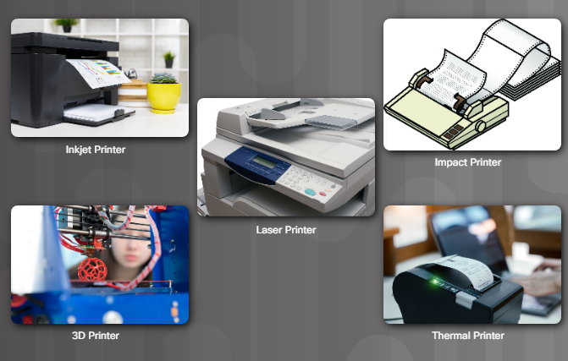
Characteristics and Capabilities Characteristics of Printers
Notes:
8.1 – Common Printer Features
8.1.1 – Characteristics and Capabilities
8.1.1.1 – Characteristics of Printers

Slide 18
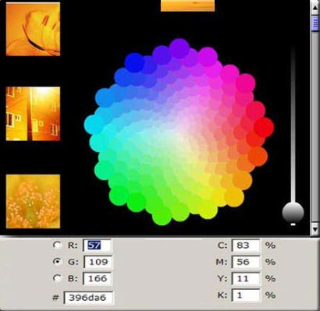
Characteristics and Capabilities Printer Speed, Quality, and Color
Speed and Quality
Speed – measured in pages per minute (ppm)
Quality – measured in dots per inch (dpi)
Color
Cyan, magenta, and yellow (CMY)
Black for inkjets is the base or key color
Notes:
8.1 – Common Printer Features
8.1.1 – Characteristics and Capabilities
8.1.1.2 – Printer Speed, Quality, and Color

Slide 19
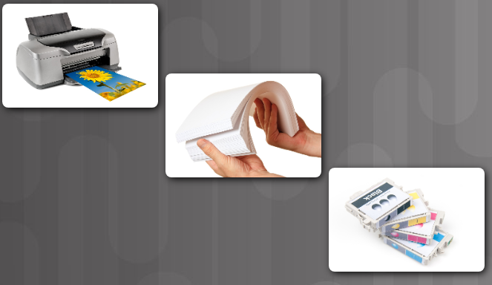
Characteristics and Capabilities Reliability and Total Cost of Ownership
Warranty
Scheduled servicing
Mean time between failures (MTBF)
Total cost of ownership (TCO)
Initial purchase price
Cost of consumable supplies
Price per page
Pages per month
Maintenance costs
Warranty costs
Notes:
8.1 – Common Printer Features
8.1.1 – Characteristics and Capabilities
8.1.1.3 – Reliability and Total Cost of Ownership

Slide 20
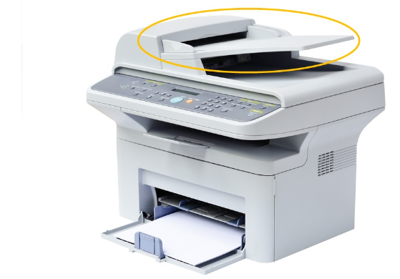
Characteristics and Capabilities Automatic Document Feeder
Automatic Document Feeder (ADF)
Used with some laser and inkjet models
Feeds paper into the printer
Might provide collation (ordering of pages)
Notes:
8.1 – Common Printer Features
8.1.1 – Characteristics and Capabilities
8.1.1.4 – Automatic Document Feeder
8.1.1.5 – Check Your Understanding – Printer Capabilities and Characteristics

Slide 21
8.2 Printer Type Comparison
Notes:
8 – Printers
8.2 – Printer Type Comparison

Slide 22
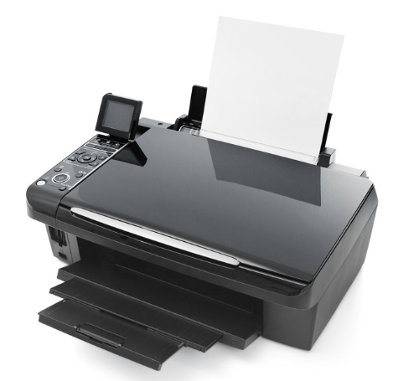
Inkjet Printers Inkjet Printer Characteristics
Easy to use
Cheaper than laser printers
Advantages
Low cost
High resolution
Disadvantages
Some nozzles prone to clog
Cartridges can be expensive
Ink can be wet after printing
Notes:
8.2 – Printer Type Comparison
8.2.1 – Inkjet Printers
8.2.1.1 – Inkjet Printer Characteristics

Slide 23
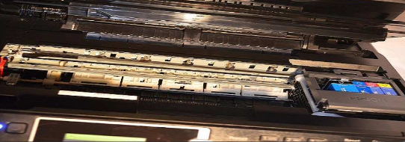
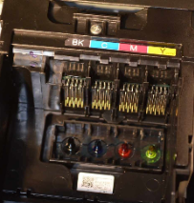
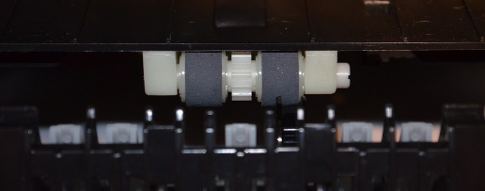
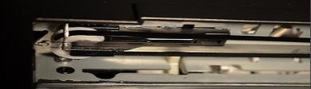
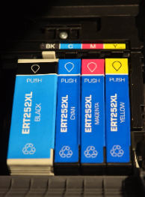
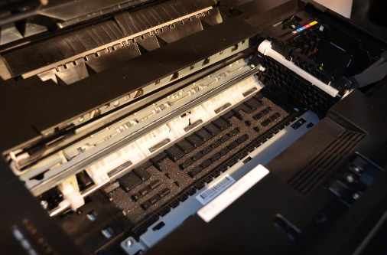
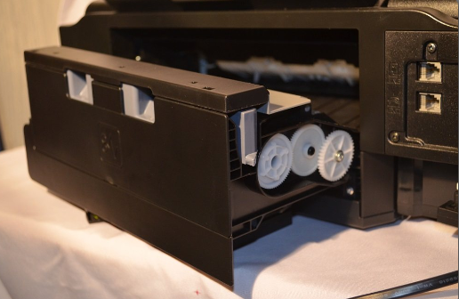

Inkjet Printers Inkjet Printer Parts
Print Head
Carriage/Belt
Roller
Ink Cartridge/ Paper
Duplexing Assembly
Feeder
Notes:
8.2 – Printer Type Comparison
8.2.1 – Inkjet Printers
8.2.1.2 – Inkjet Printer Parts
8.2.1.3 – Check Your Understanding – Inkjet Printers

Slide 24
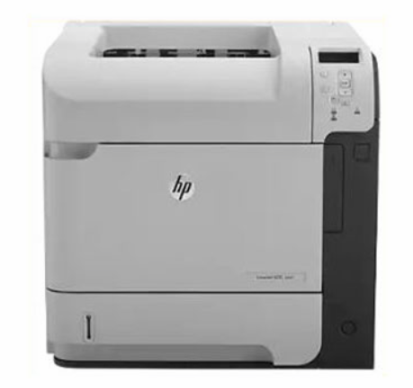
Laser Printers Laser Printer Characteristics
Advantages
Low cost per page
High PPM
High capacity
High quality
Fast (uses a laser beam or LEDs to create an image)
Print comes out dry
Disadvantages
High initial cost
Toner cartridges can be expensive
Notes:
8.2 – Printer Type Comparison
8.2.2 – Laser Printers
8.2.2.1 – Laser Printer Characteristics

Slide 25
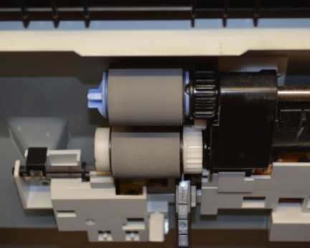
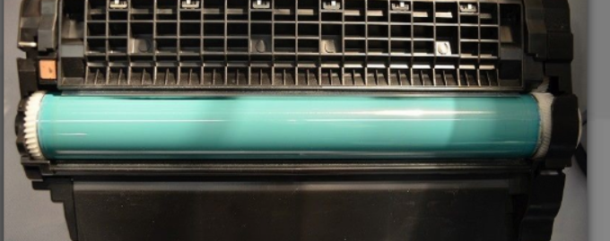
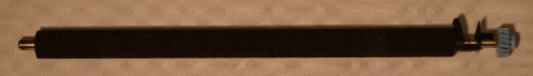
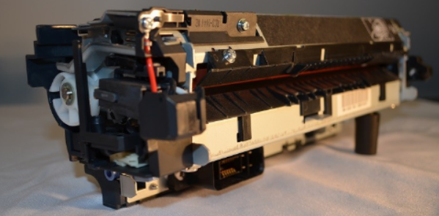
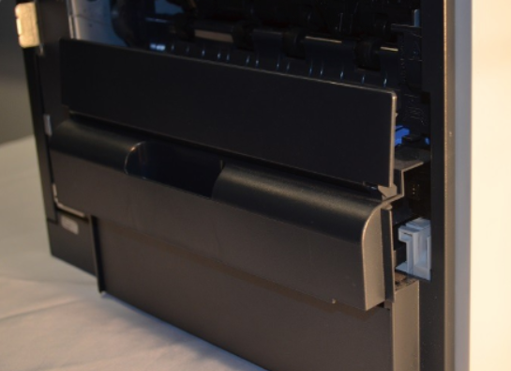
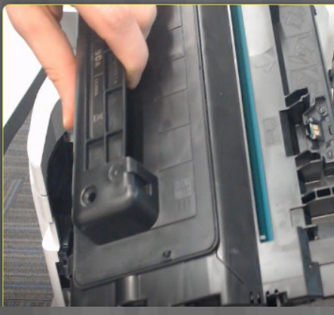
Laser Printers Laser Printer Characteristics
Transfer Roller
Pickup Rollers
Imaging Drum
Fuser Assembly
Duplexing Assembly
Toner Cartridge
Notes:
8.2 – Printer Type Comparison
8.2.2 – Laser Printers
8.2.2.2 – Laser Printer Characteristics
8.2.2.3 – Check Your Understanding – Laser Printers

Slide 26
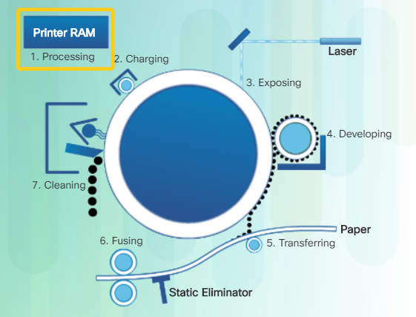
Laser Printing Process How Laser Printing Works
7 Steps of the Laser Printing Process
Processing – Convert data into a printable form
Charging – drum is conditioned for new image
Exposing – write the image to the drum using a laser beam
Developing – toner is applied to the image on the drum
Transferring – As the paper rolls through, the image is transferred to the paper due to a charge applied to the paper
Fusing – Heat and pressure are applied to the paper
Cleaning – Excess toner removed from the drum
Notes:
8.2 – Printer Type Comparison
8.2.3 – Laser Printing Process
8.2.3.1 – How Laser Printing Works
8.2.3.2 – Check Your Understanding – The Laser Printing Process

Slide 27
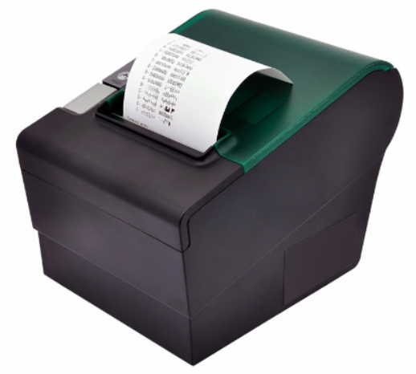
Thermal Printers and Impact Printers Thermal Printer Characteristics
Thermal printers are used in retail as part of a cash register system and within older fax machines.
Heat from the print head makes the image on the paper.
Advantages
Last a long time due to few moving parts
Quiet
No cost for ink or toner
Disadvantages
Thermal paper is expensive and must be stored at room temperature
Images on thermal paper degrade over time, are poor quality, and cannot be in color
Notes:
8.2 – Printer Type Comparison
8.2.4– Thermal Printers and Impact Printers
8.2.4.1 – Thermal Printer Characteristics

Slide 28
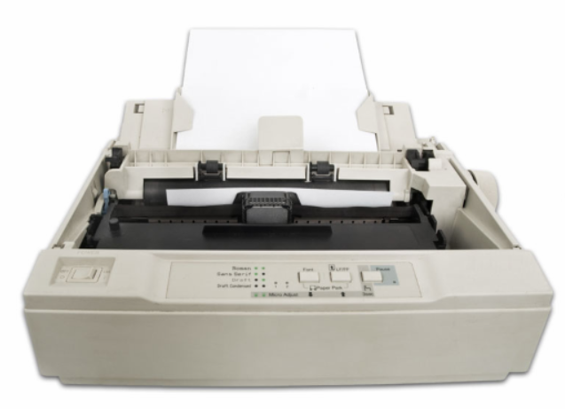
Thermal Printers and Impact Printers Impact Printer Characteristics
Impact printers – dot matrix and daisy wheel
Have print heads that strike an inked ribbon with a specific number of pins
Higher number of pins means better quality
Advantages
Ribbons are less expensive supplies than other types
Can use regular paper or continuous feed paper
Can print carbon copies
Disadvantages
Noisy
Graphics are low-resolution
Limited color capabilities
Notes:
8.2 – Printer Type Comparison
8.2.4– Thermal Printers and Impact Printers
8.2.4.2 – Impact Printer Characteristics
8.2.4.3 Check Your Understanding – Thermal Printers and Impact Printers

Slide 29
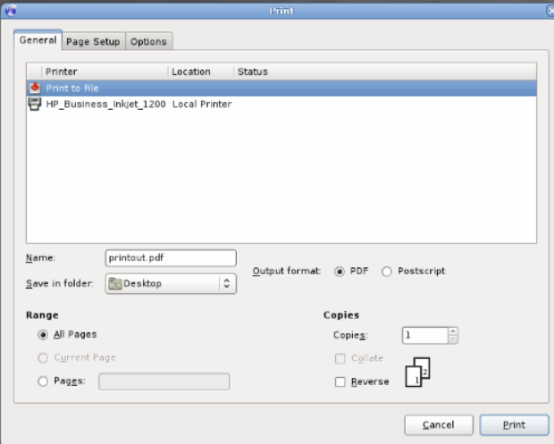
Virtual Printers Virtual Printer Characteristics
Print to file
Print to PDF
Print to XPS (XML Paper Specification)
Print to image (such as .JPG or .TIF)
Notes:
8.2 – Printer Type Comparison
8.2.5– Virtual Printers
8.2.5.1 – Virtual Printer Characteristics

Slide 30
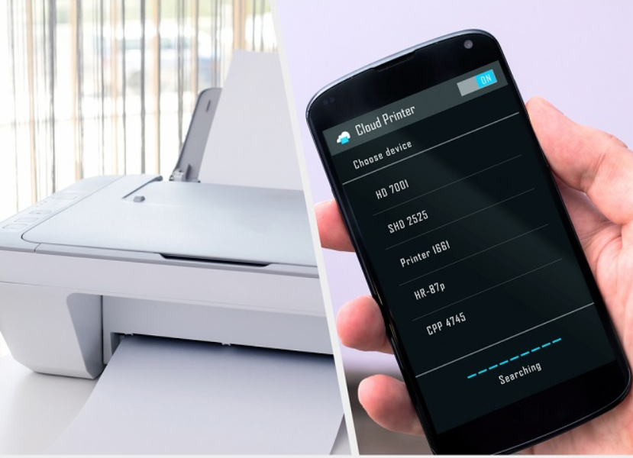
Virtual Printers Cloud Printing
Sends a print job to a remote printer somewhere on the network.
Some printing companies have software that can send print jobs to their closest location.
Google Cloud Print allows you to connect your printer to the web and you can send something to your own printer no matter where you are located.
Notes:
8.2 – Printer Type Comparison
8.2.5– Virtual Printers
8.2.5.2 – Cloud Printing
8.2.5.3 Check Your Understanding – Virtual Printers

Slide 31
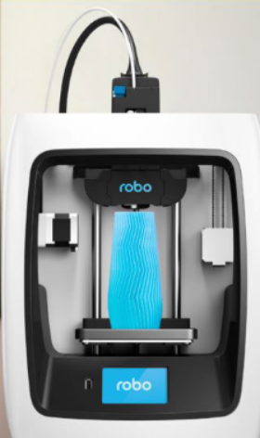
3D Printers 3D Printer Characteristics
Used to create three dimensional objects
Use plastic filament or other media to create the object
Notes:
8.2 – Printer Type Comparison
8.2.6 – 3D Printers
8.2.6.1 – 3D Printer Characteristics

Slide 32
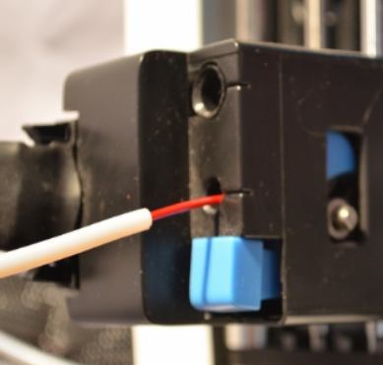
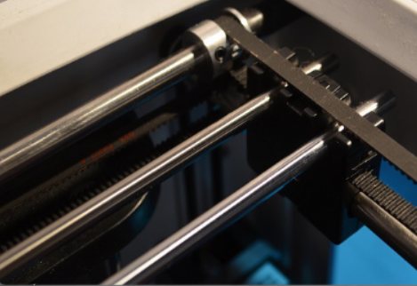
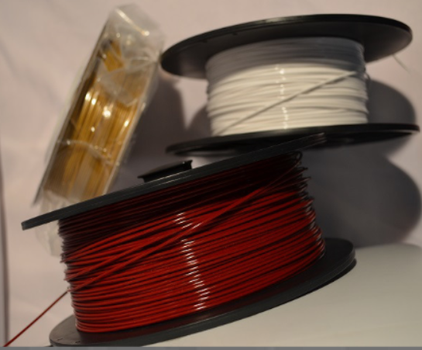
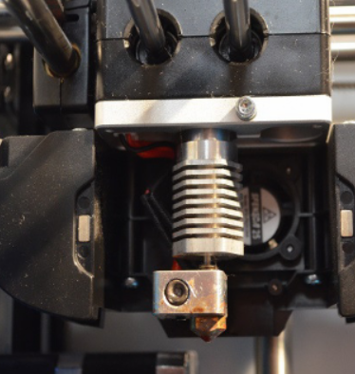
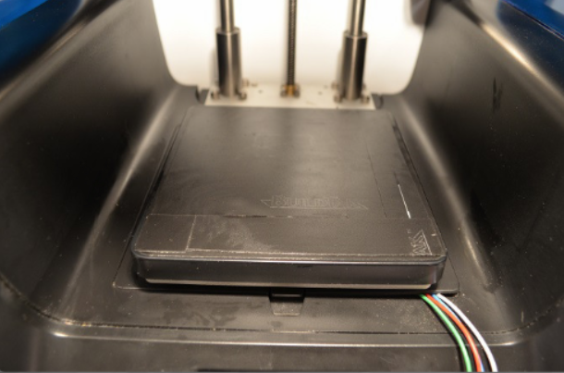
3D Printers 3D Printer Parts
Feeder
Axis
Filament
Print Bed
Hotend Nozzle
Notes:
8.2 – Printer Type Comparison
8.2.6 – 3D Printers
8.2.6.2 – 3D Printer Parts
8.2.6.3 – Check Your Understanding – 3D Printers

Slide 33
8.3 Installing and Configuring Printers
Notes:
8 – Printers
8.3 – Installing and Configuring Printers

Slide 34
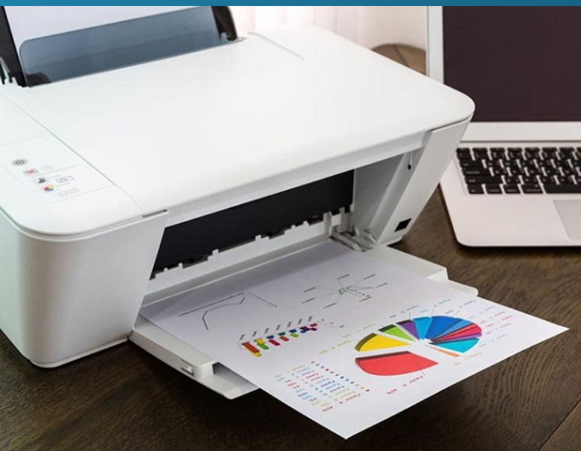
Installing and Updating a Printer Installing a Printer
Follow manufacturer’s instructions.
Remove all packing material and keep if a return is needed.
Sometimes the printer driver is installed before the printer is connected to the computer.
Connect the cable to the printer and computer or connect the network cable.
Attach power cord.
Notes:
8.3 – Installing and Configuring Printers
8.3.1– Installing and Updating a Printer
8.3.1.1 – Installing a Printer

Slide 35
Installing and Updating a Printer Lab - Install a Printer
In this lab, you will install a printer. You will find, download, and update the driver and the software for the printer.
Notes:
8.3 – Installing and Configuring Printers
8.3.1– Installing and Updating a Printer
8.3.1.2 – Lab - Install a Printer

Slide 36
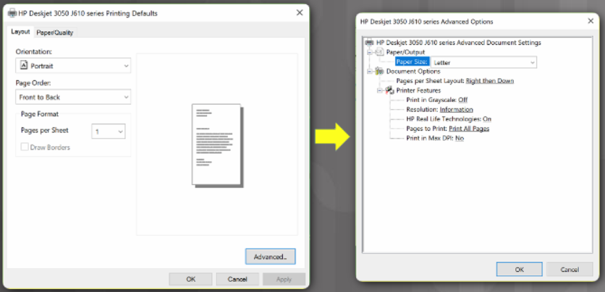
Installing and Updating a Printer Test Printer Functions
Test all functions including
Double-sided documents
Different paper trays
Grayscale and color
Draft mode
Collation
Notes:
8.3 – Installing and Configuring Printers
8.3.1– Installing and Updating a Printer
8.3.1.3 – Test Printer Functions

Slide 37
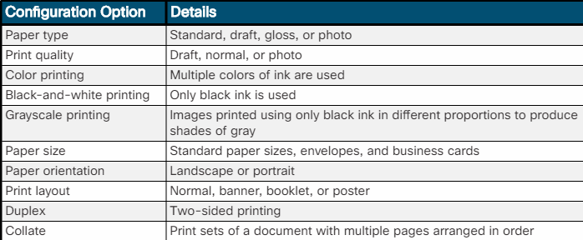
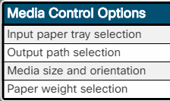
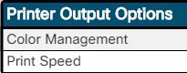
Configuring Options and Default Settings Common Configuration Settings
Notes:
8.3 – Installing and Configuring Printers
8.3.2– Configuring Options and Default Settings
8.3.2.1 – Common Configuration Settings
8.3.2.2 – Check Your Understanding – Configuration Options

Slide 38
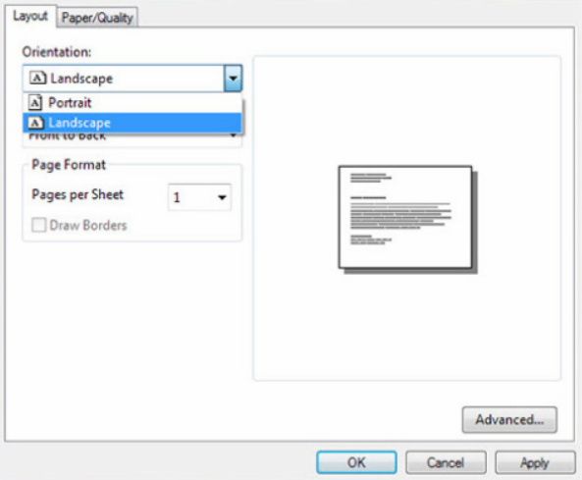
Optimizing Printer Performance Software Optimization
Use the print driver software to
Configure print spool settings
Calibrate the printer (color)
Set paper orientation
Notes:
8.3 – Installing and Configuring Printers
8.3.3– Optimizing Printer Performance
8.3.3.1 – Software Optimization

Slide 39
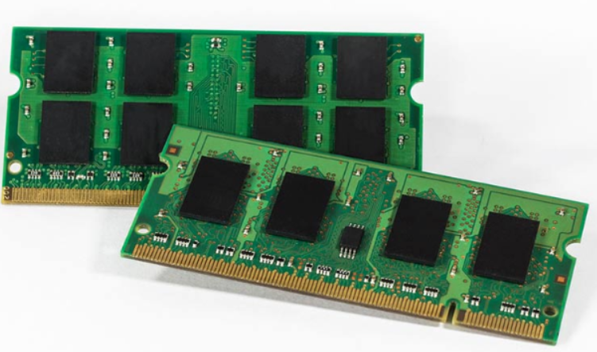
Optimizing Printer Performance Hardware Optimization
Firmware
Printer memory
Notes:
8.3 – Installing and Configuring Printers
8.3.3– Optimizing Printer Performance
8.3.3.2 – Hardware Optimization
8.3.3.3 – Check Your Understanding – Printer Optimization (Figure 1) and Printer Hardware Optimization (Figure 2)

Slide 40
8.4 Sharing Printers
Notes:
8 – Printers
8.4 – Sharing Printers

Slide 41
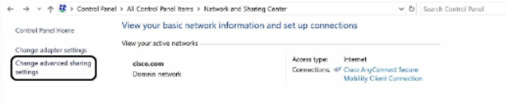
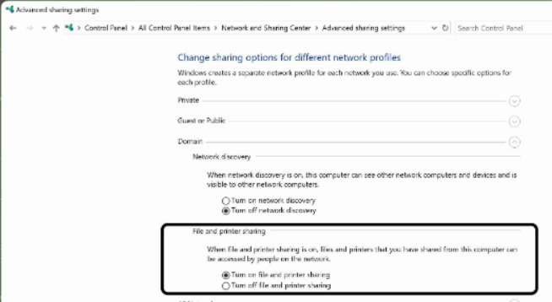
Operating System Settings for Sharing Printers Configuring Printer Sharing
Those who connect to the shared printer must have the correct print driver.
Windows can do this automatically
Notes:
8.4 – Sharing Printers
8.4.1– Operating System Settings for Sharing Printers
8.4.1.1 – Configuring Printer Sharing

Slide 42
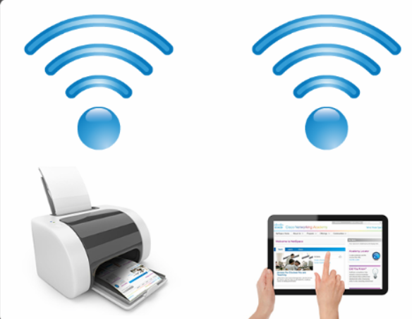
Operating System Settings for Sharing Printers Wireless Printer Connections
Bluetooth
Pairing between computer and printer
Wi-Fi
Notes:
8.4 – Sharing Printers
8.4.1– Operating System Settings for Sharing Printers
8.4.1.2 – Wireless Printer Connections

Slide 43
Operating System Settings for Sharing Printers Lab – Share a Printer in Windows
In this lab, you will share a printer, configure the printer on a networked computer, and print a test page from the remote computer.
Notes:
8.4 – Sharing Printers
8.4.1– Operating System Settings for Sharing Printers
8.4.1.3 – Lab – Share a Printer in Windows

Slide 44
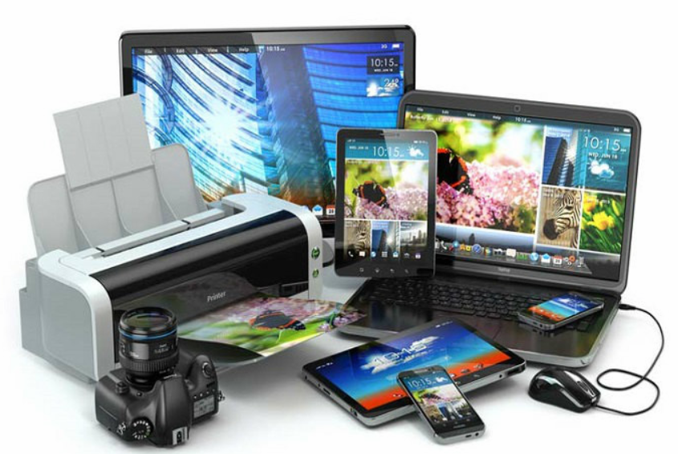
Print Servers Purposes of Print Servers
Provide client access to print resources
Administrate print jobs by storing them in a queue
Provide user feedback
Notes:
8.4 – Sharing Printers
8.4.2– Print Servers
8.4.2.1 – Purposes of Print Servers

Slide 45
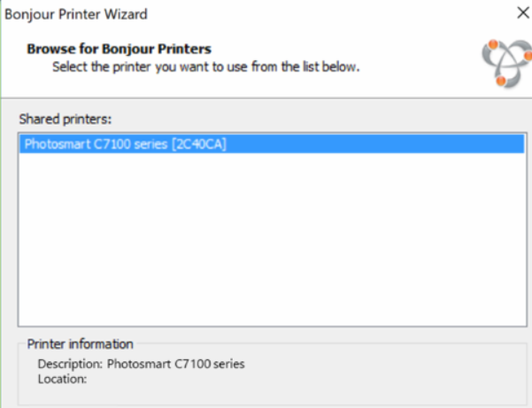
Print Servers Software Print Servers
Use print server software.
Disadvantages
Sharing a printer might cause slow downs.
If the computer sharing the printer is down, the printer is unavailable to others.
Notes:
8.4 – Sharing Printers
8.4.2– Print Servers
8.4.2.2 – Software Print Servers

Slide 46
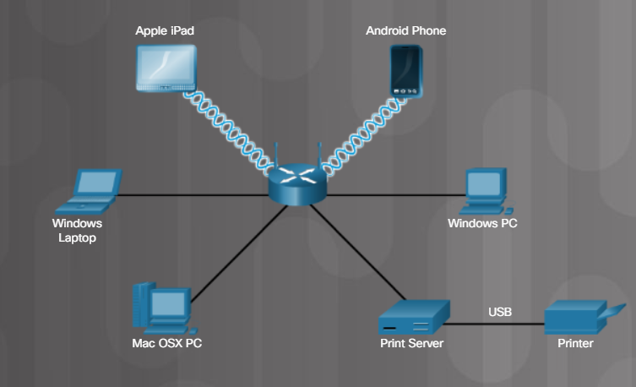
Print Servers Hardware Print Servers
Notes:
8.4 – Sharing Printers
8.4.2– Print Servers
8.4.2.3 – Hardware Print Servers

Slide 47
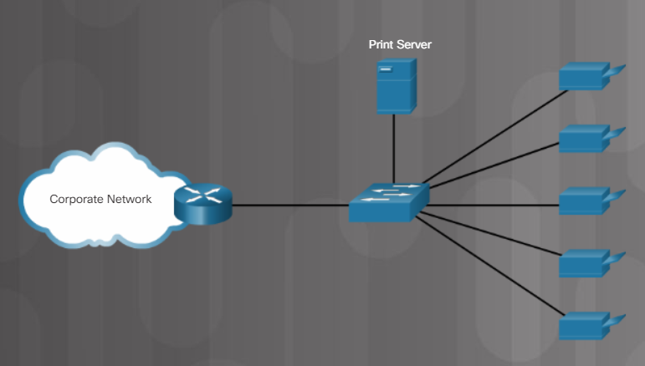
Print Servers Dedicated Print Servers
Powerful processor
Adequate storage space for queued documents
Adequate memory
Notes:
8.4 – Sharing Printers
8.4.2– Print Servers
8.4.2.4 – Dedicated Print Servers
8.4.2.5 – Check Your Understanding – Print Servers

Slide 48
8.5 Maintaining and Troubleshooting Printers
Notes:
8 – Printers
8.5 – Troubleshooting and Maintaining Printers

Slide 49
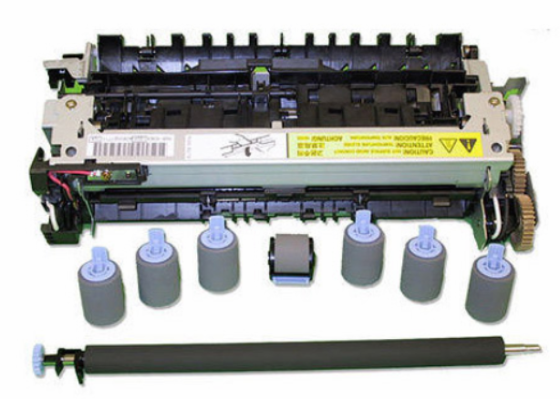
Printer Preventive Maintenance Vendor Guidelines
Refer to the printer’s documentation.
Follow recommended maintenance processes and instructions.
Some manufacturers sell maintenance kits.
Notes:
8.5 – Maintaining and Troubleshooting Printers
8.5.1– Printer Preventive Maintenance
8.5.1.1 – Vendor Guidelines
8.5.1.2 – What Do You Already Know? Printer Operating Environment

Slide 50
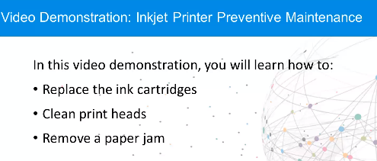
Inkjet Printer Preventive Maintenance Video Demonstration – Inkjet Printer Preventive Maintenance
Notes:
8.5 – Maintaining and Troubleshooting Printers
8.5.2– Inkjet Printer Preventive Maintenance
8.5.2.1 – Video Demonstration – Inkjet Printer Preventive Maintenance

Slide 51
Inkjet Printer Preventive Maintenance Lab – Perform Preventive Maintenance on an Inkjet Printer
In this lab, you will perform preventive maintenance on an inkjet printer. Note: The lab instructions are for general reference only. Refer to the manufacturer’s printer manual for instructions to perform preventive maintenance on your inkjet printer model.
Notes:
8.5 – Maintaining and Troubleshooting Printers
8.5.2– Inkjet Printer Preventive Maintenance
8.5.2.2 – Lab – Perform Preventive Maintenance on an Inkjet Printer

Slide 52
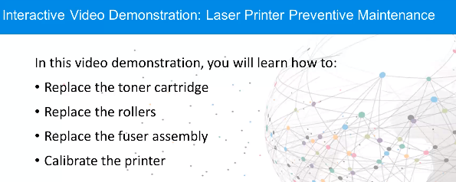
Laser Printer Preventive Maintenance Video Demonstration – Laser Printer Preventive Maintenance
Notes:
8.5 – Maintaining and Troubleshooting Printers
8.5.3– Laser Printer Preventive Maintenance
8.5.3.1 – Video Demonstration – Laser Printer Preventive Maintenance

Slide 53
Laser Printer Preventive Maintenance Lab – Perform Preventive Maintenance on a Laser Printer
In this lab, you will perform preventive maintenance on a laser printer.
Note: The lab instructions are for general reference only. Refer to the manufacturer’s printer manual for instructions to perform preventive maintenance on your laser printer model.
Notes:
8.5 – Maintaining and Troubleshooting Printers
8.5.3– Laser Printer Preventive Maintenance
8.5.3.2 – Lab – Perform Preventive Maintenance on a Laser Printer

Slide 54
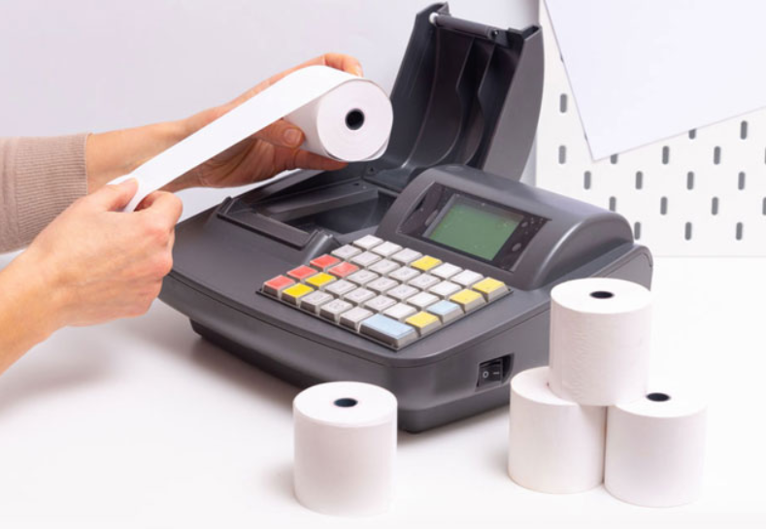
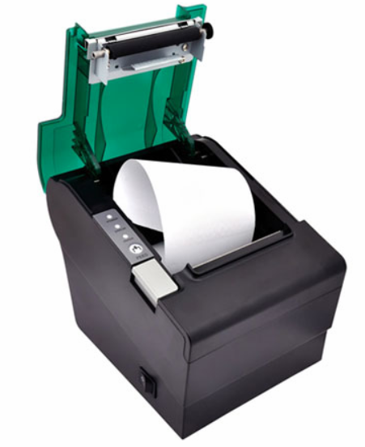
Thermal Printer Preventive Maintenance Perform Preventive Maintenance on a Thermal Printer
Refer to the printer’s documentation.
Replace the paper.
Clean the heating element with a cotton swab dampened with isopropyl alcohol.
Use compressed air or a ling-free cloth to remove debris.
Notes:
8.5 – Maintaining and Troubleshooting Printers
8.5.4 – Thermal Printer Preventive Maintenance
8.5.4.1 – Perform Preventive Maintenance on a Thermal Printer
8.5.4.2 – Check Your Understanding – Thermal Printer Preventive Maintenance

Slide 55
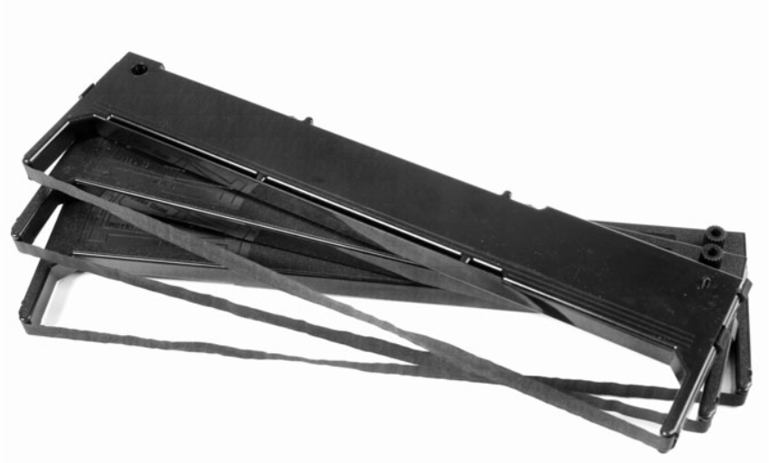

Impact Printer Preventive Maintenance Perform Preventive Maintenance on an Impact Printer
Refer to the printer’s documentation.
Replace the ribbon.
Check character quality – might need to replace the print head.
Notes:
8.5 – Maintaining and Troubleshooting Printers
8.5.5– Impact Printer Preventive Maintenance
8.5.5.1 – Perform Preventive Maintenance on an Impact Printer
8.5.5.2 – Check Your Understanding – Impact Printer Preventive Maintenance

Slide 56

3D Printer Preventive Maintenance Video Demonstration – 3D Printer Preventive Maintenance
Notes:
8.5 – Maintaining and Troubleshooting Printers
8.5.6– 3D Printer Preventive Maintenance
8.5.6.1 – Video Demonstration – 3D Printer Preventive Maintenance

Slide 57

3D Printer Preventive Maintenance Video Demonstration – 3D Printer Printing a Component
Notes:
8.5 – Maintaining and Troubleshooting Printers
8.5.6– 3D Printer Preventive Maintenance
8.5.6.2 – Video Demonstration – 3D Printer Printing a Component
8.5.6.3 – Check Your Understanding – 3D Printer Preventive Maintenance

Slide 58

Troubleshooting Printing Issues The Six Steps of the Troubleshooting Process
Notes:
8.5 – Maintaining and Troubleshooting Printers
8.5.7– Troubleshooting Printing Issues
8.5.7.1 – The Six Steps of the Troubleshooting Process

Slide 59

Troubleshooting Printing Issues Identify the Problem
Notes:
8.5 – Maintaining and Troubleshooting Printers
8.5.7– Troubleshooting Printing Issues
8.5.7.2 – Identify the Problem

Slide 60

Troubleshooting Printing Issues Establish a Theory of Probable Cause
Notes:
8.5 – Maintaining and Troubleshooting Printers
8.5.7– Troubleshooting Printing Issues
8.5.7.3 – Establish a Theory of Probably Cause

Slide 61

Troubleshooting Printing Issues Test the Theory to Determine Cause
Notes:
8.5 – Maintaining and Troubleshooting Printers
8.5.7– Troubleshooting Printing Issues
8.5.7.4 – Test the Theory to Determine Cause

Slide 62

Troubleshooting Printing Issues Establish a Plan of Action to Resolve the Problem and Implement the Solution
Notes:
8.5 – Maintaining and Troubleshooting Printers
8.5.7– Troubleshooting Printing Issues
8.5.7.5 – Establish a Plan of Action to Resolve the Problem and Implement the Solution

Slide 63

Troubleshooting Printing Issues Verify Full System Functionality and, If Applicable, Implement Preventive Measures
Notes:
8.5 – Maintaining and Troubleshooting Printers
8.5.7– Troubleshooting Printing Issues
8.5.7.6 – Verify Full System Functionality and, If Applicable, Implement Preventive Measures

Slide 64

Troubleshooting Printing Issues Document Findings, Actions, and Outcomes
Notes:
8.5 – Maintaining and Troubleshooting Printers
8.5.7– Troubleshooting Printing Issues
8.5.7.7 – Document Findings, Actions, and Outcomes

Slide 65

Problems and Solutions Identify Printer Problems and Solutions
Notes:
8.5 – Maintaining and Troubleshooting Printers
8.5.8 – Problems and Solutions
8.5.8.1 – Identify Printer Problems and Solutions

Slide 66

Problems and Solutions Common Problems and Solutions for Printers
Notes:
8.5 – Maintaining and Troubleshooting Printers
8.5.8 – Problems and Solutions
8.5.8.2 – Common Problems and Solutions for Printers

Slide 67

Problems and Solutions Common Problems and Solutions for Printers (cont.)
Notes:
8.5 – Maintaining and Troubleshooting Printers
8.5.8 – Problems and Solutions
8.5.8.2 – Common Problems and Solutions for Printers

Slide 68
8.6 Chapter Summary
Notes:
8 – Printers
8.6 – Chapter Summary

Slide 69
Section 8.6 New Terms and Commands
Laser printer Inkjet printer Impact printer Thermal printer 3D printer ADF Print head Roller Feeder Duplexing assembly Ink cartridge Carriage/belt Imaging drum Toner cartridge | Fuser assembly Transfer roller Pickup rollers Processing Charging Exposing Developing Transferring Fusing Cleaning Virtual printer Print to file Print to PDF Print to XPS | Print to image Cloud printing Plastic filament Filament Feeder Hotend Nozzle Axis Print bed Printer driver Collation Hardware print server Software print server Dedicated print server Preventive maintenance
Notes:
Chapter 8 - New Terms and Commands

